Slide 1

01
B2B Cleaning Supplies
Last-Mile Delivery Tracker
Review 1 Presentation — Week 1
Ganga Maxx Marketplace
Gudelly Goverdhan-252U1R1098 Frontend Developer | | Thota Shashank -252U1R1119Backend Developer
Katta Goutham Krishna-252U1R1243 Testing & Deployment
GM
06 June 2026
Internship Batch 2026
Notes:
Welcome the reviewers. Introduce the project name, the company Ganga Maxx Marketplace, and your team of three students with their roles. Mention this is your Review 1 presentation at the end of Week 1.

Slide 2
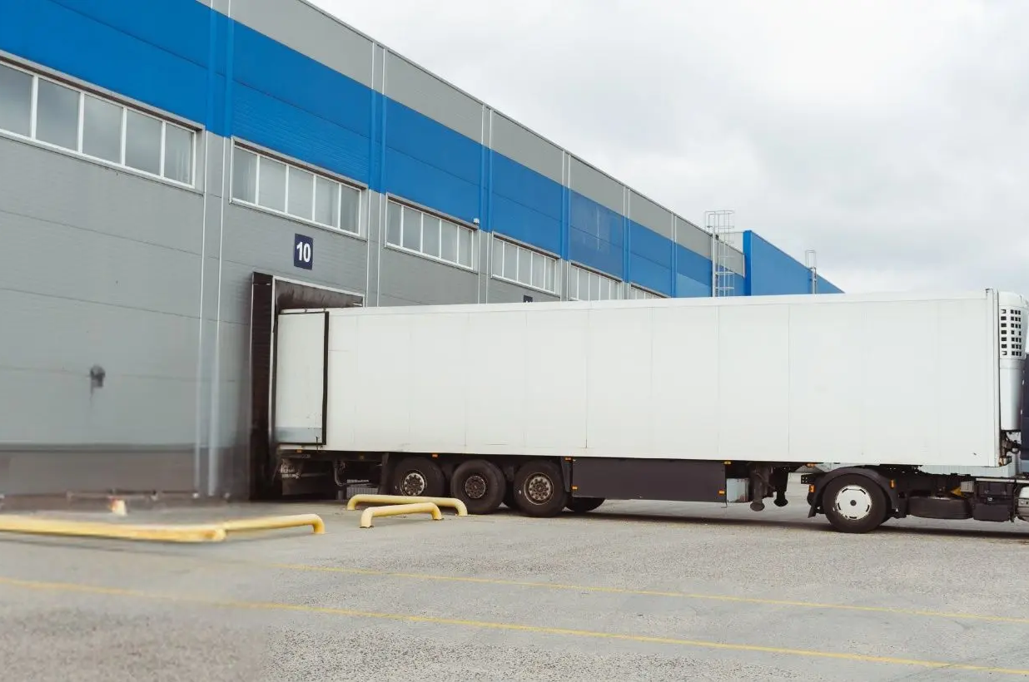
About the Company
Ganga Maxx Marketplace is a B2B platform specialising in cleaning and hygiene product sales to institutional customers.
Key business operations:
Institutional ordering and contract pricing
Warehouse stock control and SKU management
Credit account management for bulk buyers
Delivery tracking across multi-stop routes
Chemical handling compliance documentation
Customers served: Schools, hospitals, hotels, and dealers across the region.
Why digital: Manual processes cannot scale with high-volume daily deliveries to multiple institutions.
Ganga Maxx Marketplace
GANGA MAXX INTERNSHIP
Notes:
Emphasise that Ganga Maxx is a real B2B operation with complex daily logistics. Mention the variety of institutional customers. Avoid reading every bullet point verbatim — highlight 2-3 key operations and move on.

Slide 3
Project Domain & Technology Overview
03
Operations / Delivery Management
Architecture
Technology Stack & Architecture
01 / Presentation
Frontend
HTML5, CSS3, JavaScript / React
Run dashboards, driver logs, and mobile signature canvas views.
02 Backend
Node.js Express / Python Flask
RESTful APIs handling stop sequences, updates, and validations.
03
Database
MySQL / PostgreSQL / Firebase
Structured schemas for SKUs, active run orders, and POD metadata.
04 AI & Rules
Rule-based Sequencing Logic
Route priority logic and skipped stop escalations.
05 / Notification
Integrations
WhatsApp API & PDF Export
Automated dispatcher notifications and receipt exports.
Ganga Maxx Marketplace | B2B Delivery Tracker10 / 11
GANGA MAXX
GANGA MAXX
Notes:
Keep this brief. State your department, duration, and team roles clearly. Mention what the company expects — a functional prototype. Transition naturally to the project overview next.

Slide 4
Project Title &
Domain Overview
04
B2B Cleaning Supplies Last-Mile Delivery Tracker
Full Name: B2B Cleaning Supplies Last-Mile Delivery Tracker
Domain: Last-mile logistics, B2B institutional sales, delivery operations
What is last-mile delivery?
The final leg of delivery from Ganga Maxx warehouse to the customer's institution (school, hospital, hotel).
Key modules:
Delivery run creation
Route sequencing
Staff assignment
Quantity tracking
Proof of delivery
Positioning: A digital coordination hub replacing WhatsApp and spreadsheets for bulk cleaning supply deliveries to multiple institutions.
Target Users Input side:
Institutional Customer, Facility Manager
Housekeeping Manager, Dealer
Target Users Operations side:
Sales Admin, Warehouse Staff, Salesman
Delivery Coordinator, Accounts Manager, Compliance Admin
GANGA MAXX
GANGA MAXX
Notes:
Define last-mile delivery clearly for non-technical reviewers — it is the final warehouse-to-institution leg. Explain the two-sided user base (input side and operations side) to show you understand the full business context.

Slide 5
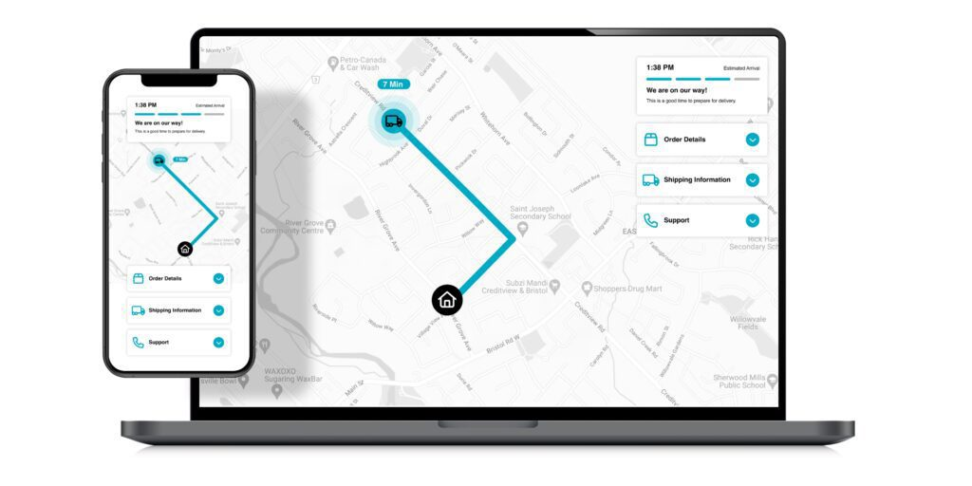
The Problem
Statement
Current Situation
Ganga Maxx currently manages bulk institutional deliveries through a manual process:
Phone calls to coordinate delivery times
WhatsApp messages for quantity updates
Spreadsheets to track deliveries
Key pain points:
No defined delivery sequence \u2014 random stop order
No real-time tracking for the coordinator
Wrong quantities to wrong institutions
Affected: Delivery Coordinator, Warehouse Staff, institutional customers.
Scale: Multiple institutions per run, high SKU volume, complex daily coordination.
- Wasted time for the team
- Slow response to important customers or priority cases
- Missed revenue opportunities because follow-ups are delayed
- No clean system to track progress, ownership, and history
GANGA MAXX INTERNSHIP
Notes:
Set the stage for why this project matters. Describe the current manual process briefly — calls, WhatsApp, spreadsheets. Highlight that this affects real people: the coordinator, warehouse staff, and customers.

Slide 6
Impact & Gap
Consequences
01
Return trips, customer complaints, missed deliveries, and direct revenue loss. Each failed delivery costs time, fuel, and customer trust.
06
02
The Gap
No digital proof of delivery. No assignment tracking. No failed-delivery reason capture. The coordinator has zero visibility once the vehicle leaves the warehouse.-
No clean system to track progress, ownership, and history
"Currently, the Delivery Coordinator faces incorrect and untracked deliveries when managing multi-institution bulk runs, resulting in return trips, customer complaints, and revenue loss. This project will build a web-based last-mile delivery tracker so that every delivery is sequenced, tracked, and verified with digital proof."
03
Business Cost
Wasted staff hours, slow response to delivery issues, and missed revenue opportunities from inefficient route planning.
GANGA MAXX
Notes:
Pause here after presenting the problem statement. Invite reviewers to ask questions before moving to the solution. The problem statement sentence is the anchor — read it clearly and slowly.

Slide 7
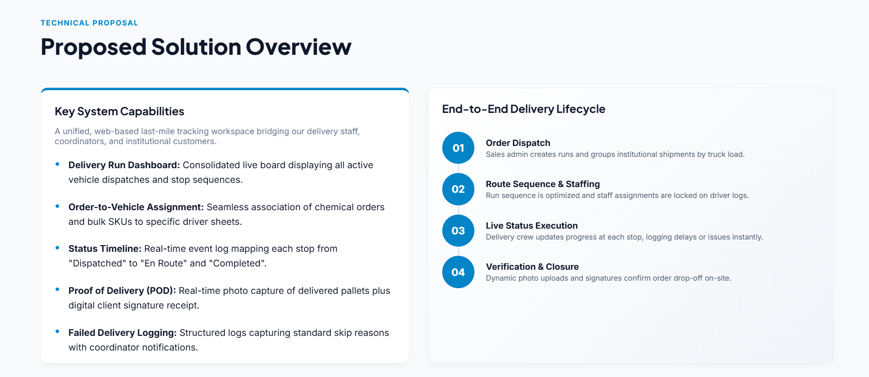
Proposed Solution
Overview
A web-based last-mile delivery tracker that gives the Delivery Coordinator full visibility and control over every institutional delivery.
Key capabilities:
Delivery run dashboard \u2014 all active runs at a glance
Order-to-vehicle assignment
Delivery status timeline \u2014 live updates per stop
Customer acknowledgement fields
Failed delivery reason capture
Route report view for post-delivery analysis
End-to-end flow:
Order dispatch Route assignment Live status update Customer acknowledgement + Proof of delivery
GANGA MAXX
Notes:
Keep this high-level. Do not go deep into code or technical details yet — that comes in the tech stack slide. Focus on what the system does and the 4-step end-to-end flow.

Slide 8
Five Measurable Goals
01
Delivery Run Dashboard
Display all active institutional deliveries with status, sequence, and assigned staff in one view.
Project Objectives
02
Backend API System
Validate delivery inputs, store records with timestamps, and return real-time status to the frontend.
03
Digital Proof of Delivery
Capture photo uploads and customer acknowledgement signatures at every delivery stop.
04
Failed Delivery Alerts
Create a reason capture flow with automatic escalation alerts to the Delivery Coordinator.
05
Deploy Prototype
Deploy a functional prototype via public URL with GitHub repo, test report, and demo video.
GANGA MAXX
Notes:
Read each objective confidently and clearly. Be ready to explain how each objective will be measured — for example, the dashboard is measured by whether it displays all active deliveries; the prototype is measured by the public URL and demo video.

Slide 9
Project Abstract
GM
Elevator Pitch
Ganga Maxx Marketplace handles the bulk distribution of commercial cleaning and hygiene products to diverse institutional buyers such as hotels, schools, and healthcare facilities. Currently, local last-mile delivery runs suffer from major operational visibility blindspots, relying on fragmented communication channels like WhatsApp, voice calls, and paper invoices, which triggers delivery quantity disputes and missed drops.
To mitigate these issues, this project introduces a web-based last-mile delivery tracking system designed to organize vehicle stops, verify SKU loads, and capture instant digital signatures and photo proof on-site. Utilizing a robust tech stack of HTML, CSS, JavaScript, Node.js, and a structured SQL database, the prototype will deliver automated alerts for skipped stops, establishing clean billing proof. The final working build will be deployed publicly by 30 June 2026, fully validating dispatch operations.
GANGA MAXX
Notes:
Read the abstract slowly and clearly — this is the elevator pitch of the entire project. It should take about 60-90 seconds to read aloud. Make eye contact with reviewers during key sentences.

Slide 10
Week 1 Progress & Project Plan
GM
Week 1 Completed
Problem statement drafted and refined
Project abstract written
5 objectives defined and documented
Wireframes sketched for 3 screens: input form, delivery status timeline, dashboard
GitHub repository created with /frontend, /backend, /docs, /tests folders
Development environment set up (VS Code, Node.js, Postman)
4-Week Timeline
Week | Focus | Deliverables
Week 1 | Planning & Setup | Problem statement, abstract, objectives, wireframes, GitHub repo, dev environment
Week 2 | Design & Foundation | Literature survey, database design, initial code, architecture diagram
Week 3 | Core Development | Feature build, API integration, testing, Review 2 presentation
Week 4 | Integration & Deploy | Full build, deployment, final testing, report, demo video, Review 3
GANGA MAXX
Thank you. We welcome your feedback and questions.
Notes:
End confidently. Summarise Week 1 achievements quickly, then walk through the 4-week timeline. Mention that the GitHub repository is live and available for review. Open the floor for questions.

